Slide 1

The AAS-Webclient-Project
Software Engineering I
TINF22F
10.11.2023

Slide 2

Introduction of the Team

Slide 3

Ilir Emini
Student Number: | 1640668
E-Mail: | Inf22198@lehre.dhbw-stuttgart.de
Role: | Projectleader

Slide 4

David Bauer
Student Number: | 9414366
E-Mail: | Inf22167@lehre.dhbw-stuttgart.de
Role: | Productmanager

Slide 5

Lara Lorke
Student Number: | 7466627
E-Mail: | Inf22132@lehre.dhbw-stuttgart.de
Role: | System Architect

Slide 6

Armin Taktar
Student Number: | 8496233
E-Mail: | Inf22148@lehre.dhbw-stuttgart.de
Role: | System Architect

Slide 7

Ümmühan Ay
Student Number: | 7060837
E-Mail: | Inf22124@lehre.dhbw-stuttgart.de
Role: | Documentation

Slide 8

Rafael Sancho Pernas
Student Number: | 4970668
E-Mail: | Inf22078@lehre.dhbw-stuttgart.de
Role: | Developer

Slide 9

Kyle Zieher
Student Number: | 7629137
E-Mail: | Inf22210@lehre.dhbw-stuttgart.de
Role: | Test Manager

Slide 10
Topics
Master Usecase
Funktional Requirements
Nonfunctional Requirements
Business Case and PM
Technical Details
Preview and Reflection

Slide 11
1. Master Usecase

Slide 12
1.1 Project Overview
AAS: Visual Depiction of products, which are called assets
Fraunhofer Project

Slide 13
1.2 Goals of the Project
Acces via URL for the User
Clearly display of assets
Nameplate Generator
Mode Managing
Documentation
Host-System (and Installation)
Testing aganst diverse AAS Server Infrastructure
Hierarchical Structures enabling Bills of Material

Slide 14
1.3 Use Cases (short description)
Dashboard (Operations and Access)
Language Manuals
Clear Description of the Components
Clear Description of Error
Simple Asset-Call (URL-Call and depiction of the Assets)
Simple Operations with the assets
Sorting and Filtering
Download-Function
Nameplate-Generator-Support
Mode Management
Application is Adaptive

Slide 15
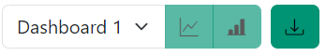
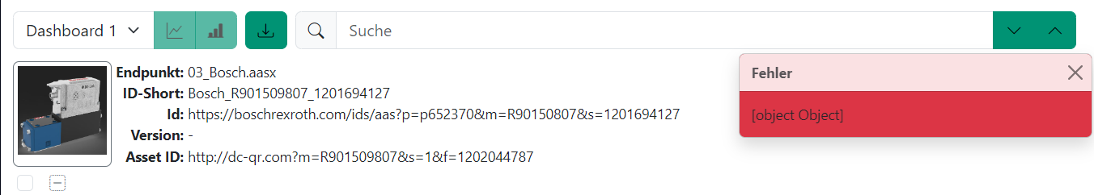
Examples

Slide 16
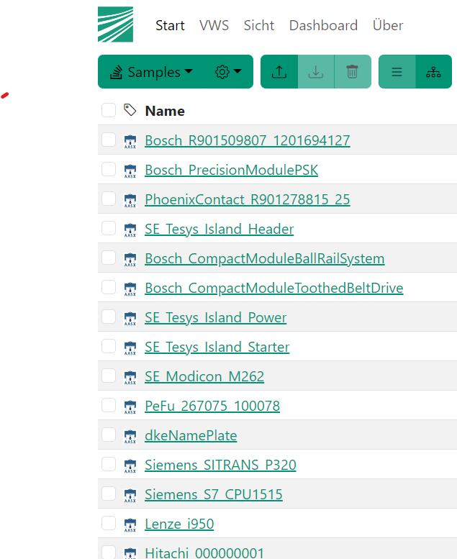
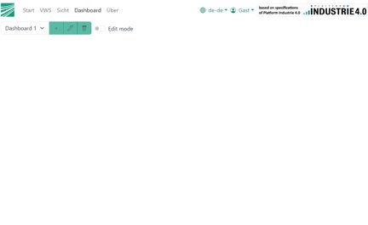
Examples

Slide 17
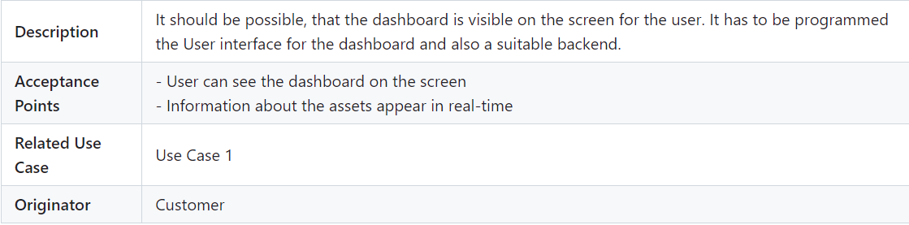
2. Functional Requirements
Access to dashboards

Slide 18
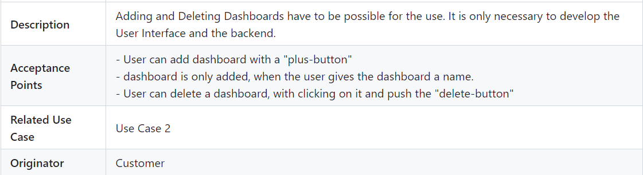
2. Functional Requirements
Operations on dashboards

Slide 19
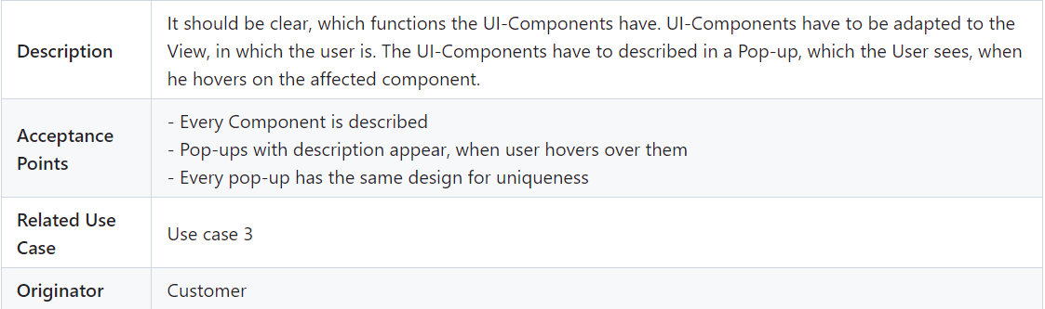
2. Functional Requirements
Functionalities of components

Slide 20
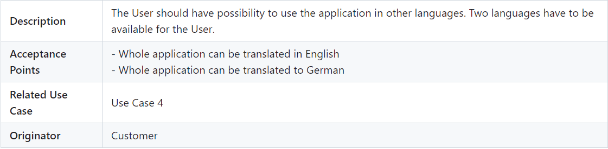
2. Functional Requirements
Language changing function

Slide 21
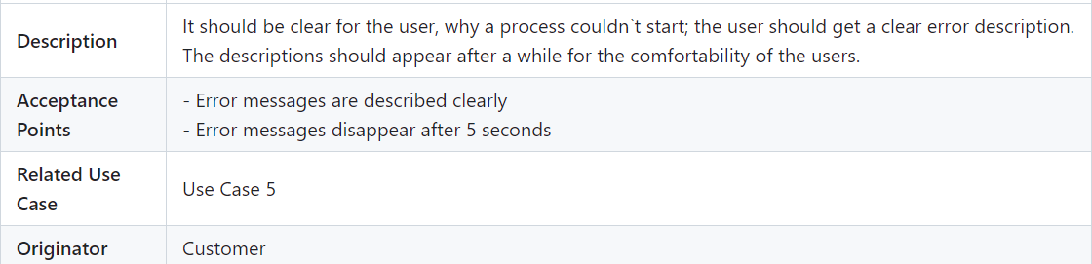
2. Functional Requirements
Clear error detection

Slide 22
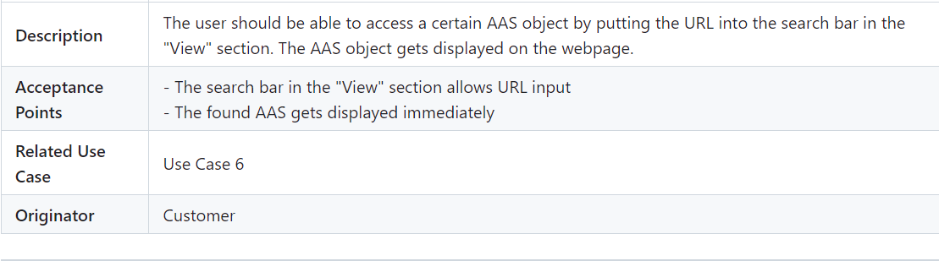
2. Functional Requirements
Access via URL

Slide 23
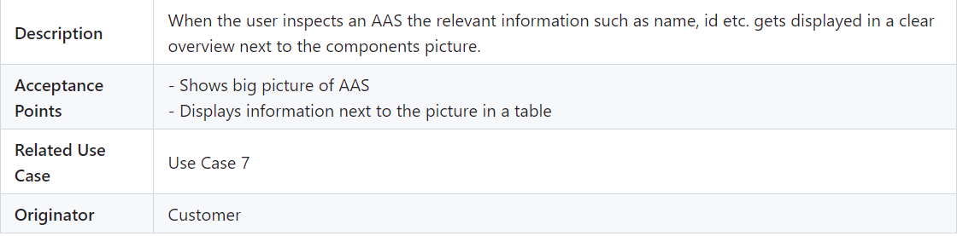
2. Functional Requirements
Display asset information

Slide 24
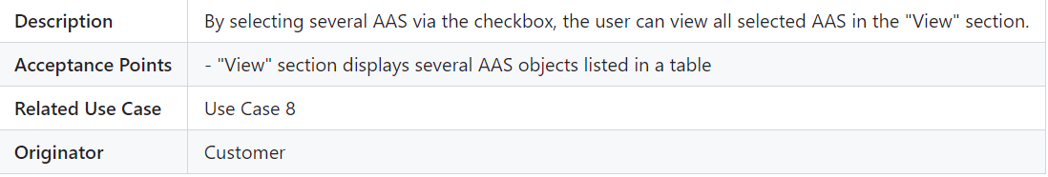
2. Functional Requirements
Parallel selection of assets

Slide 25
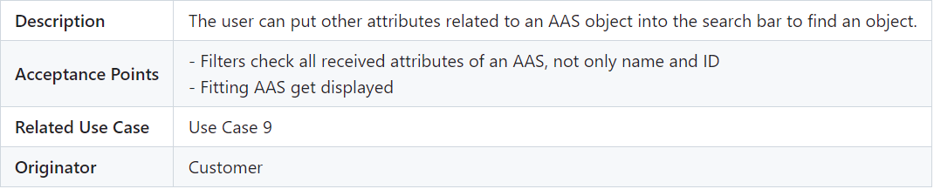
2. Functional Requirements
Sort and filter function

Slide 26
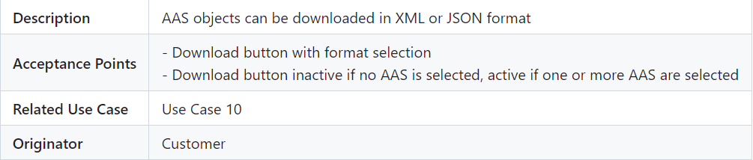
2. Functional Requirements
Download function

Slide 27
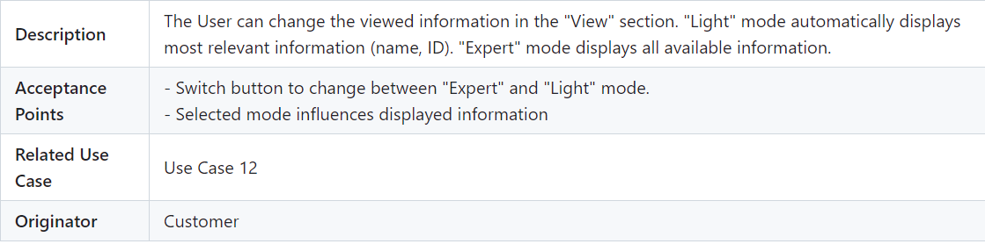
2. Functional Requirements
Mode switch

Slide 28
2. Functional Requirements
Integrated Nameplate Generator
Description | The Nameplate Generator should be integrated and improved in the application.
Acceptance Points | - API is implemented. - Generator works (QR-Code can be scanned). - fast Server connection
Related Use Case | Use Case 11
Originator | Customer

Slide 29
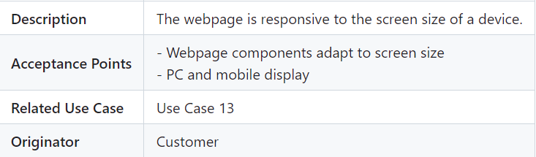
2. Functional Requirements
Adapted window size for asset information

Slide 30
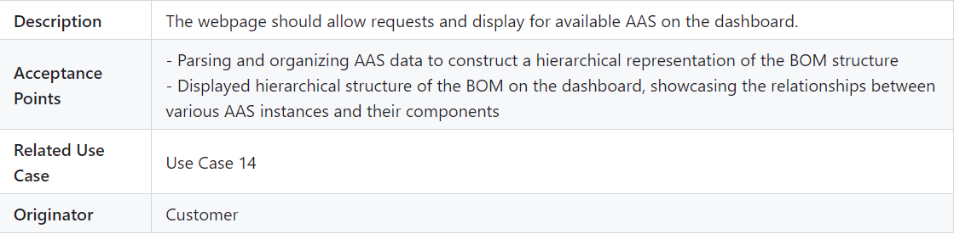
2. Functional Requirements
Support of "Hierarchical Structures enabling Bills of Material"

Slide 31
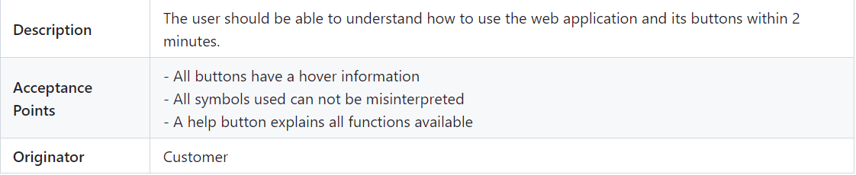
3. Nonfunctional Requirements
Usability

Slide 32
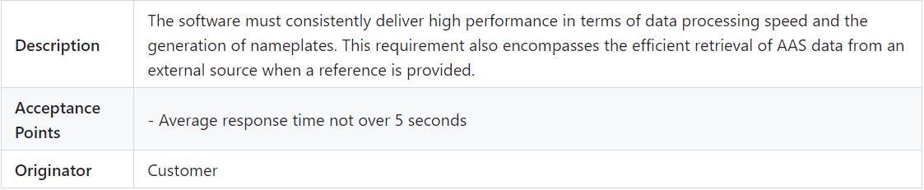
3. Nonfunctional Requirements
Performance

Slide 33
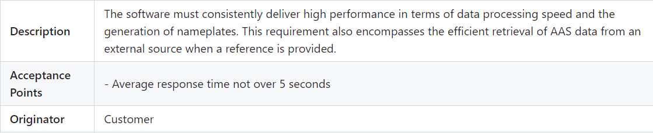
3. Nonfunctional Requirements
Availability

Slide 34
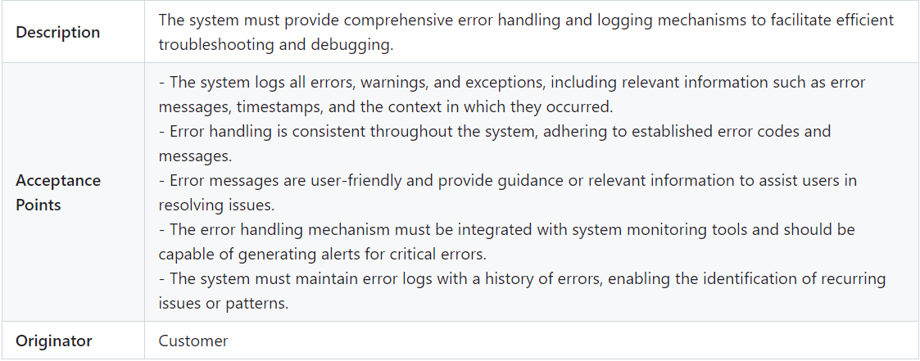
3. Nonfunctional Requirements
Error Handling

Slide 35
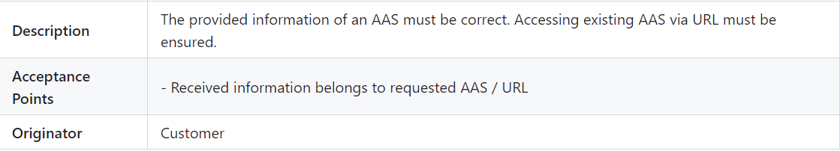
3. Nonfunctional Requirements
Reliability

Slide 36
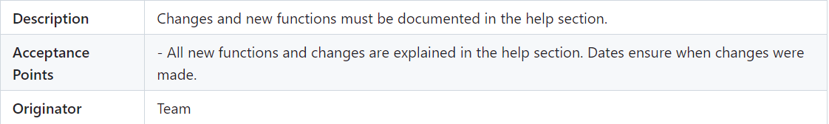
3. Nonfunctional Requirements
Documentation

Slide 37
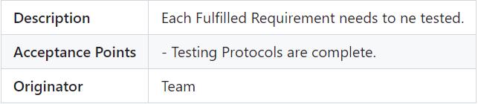
3. Nonfunctional Requirements
Testing

Slide 38

4. Business Case and PM

Slide 39
4.1 Business Case
Profit Calculation
Labor Cost Reduction: Currently after Completion
Smaller Maintenance Cost : 300€/m 150€/m
Estimated technical cost reduction:
Less running Servers: 8000€/m 4500€/m
Less technical Support needed: 1500€/m 750€/m
Electricity: 13500€/m 9000€/m
Other Costs:
Software Licenses: 200€/m 130€/m
Additional Software Courses: 700€/m 400€/m
Total Cost Reduction: 24.200€/m 14.930€/m Return on Investment (ROI): The expected ROI is estimated at 38,30579% over the first two years, taking into account increased revenue and reduced operational costs.

Slide 40
4.2 Methods and Tools
Risk Analysis
Analogical Method
GANTT-Diagram

Slide 41
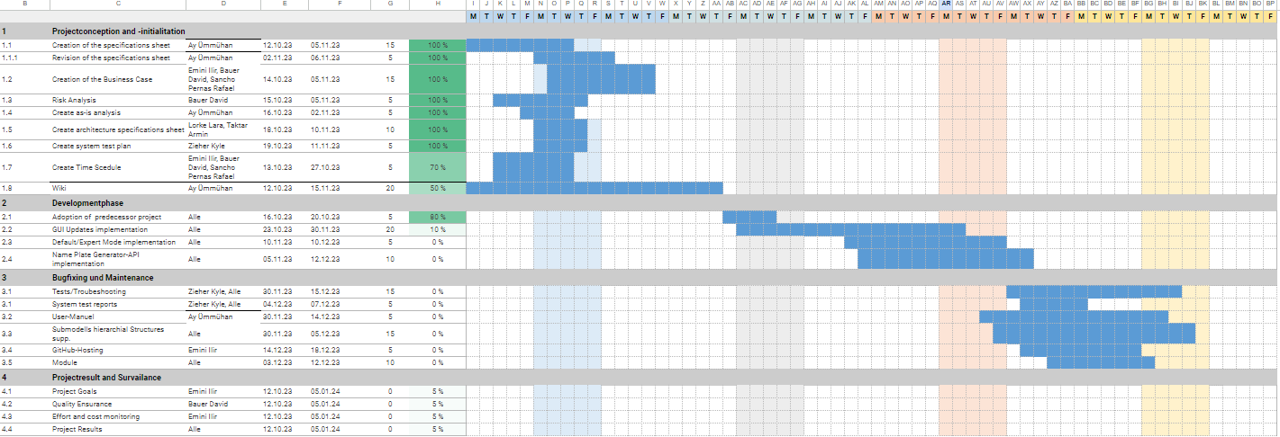
4.3 Project Plan

Slide 42

5. Technical Details

Slide 43
5.1 Key Components
aas-portal: The browser app of AASPortal.
aas-server: The Node.js server app of AASPortal.
aas-lib: UI components and services in an Angular library.
common: Types and functions used by aas-portal and aas-server.

Slide 44
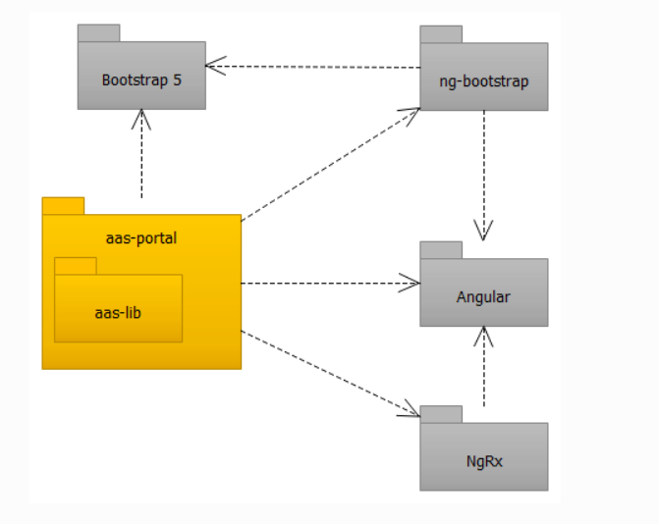
5.1 Key Components
Architectural Concept: AAS Portal

Slide 45
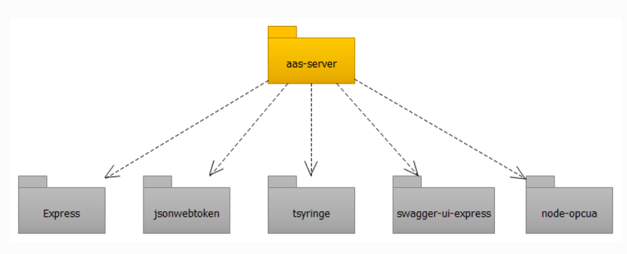
5.1 Key Components
Architectural Concept: AAS Server

Slide 46
5.2 Technologies
JavaScript (JS): Utilized for client-side scripting and enhancing user interactivity.
TypeScript (TS): Enhancing code maintainability and scalability through static typing.
JSON: Employed for data interchange between the client and server.
CSS: Styling and layout design for the AAS Portal's user interface.
HTML: Markup language used to structure the content of web pages.
Docker: Containerization technology for streamlining deployment and managing dependencies.
Angular: The Angular framework is used for building the user interface (UI) of the AAS Portal. It provides a robust structure for creating dynamic, single-page applications, ensuring a smooth and responsive user experience.

Slide 47

5.3 Authorization and Security
Authorization with JSON Web Tokens
HS256 Encryption: RS-Algorithm

Slide 48

5.4 Endpoints
An endpoint is an URL and a unique name to an AAS container. An AAS container can be:
AASX Server
OPC UA Server
AAS Registry
Directory in a file system that contains *.aasx files

Slide 49
6. Preview next semester and reflection
Communication between the members
Communication with the Professor
More Acitivity/ Organization
Next Semester: Building a Prototype
Other Documents

Slide 50


This is the end dear audience
I am proud of you!

